Slide 1
Web Engineering CRUD Operation using Laravel
Lecture 24

Slide 2
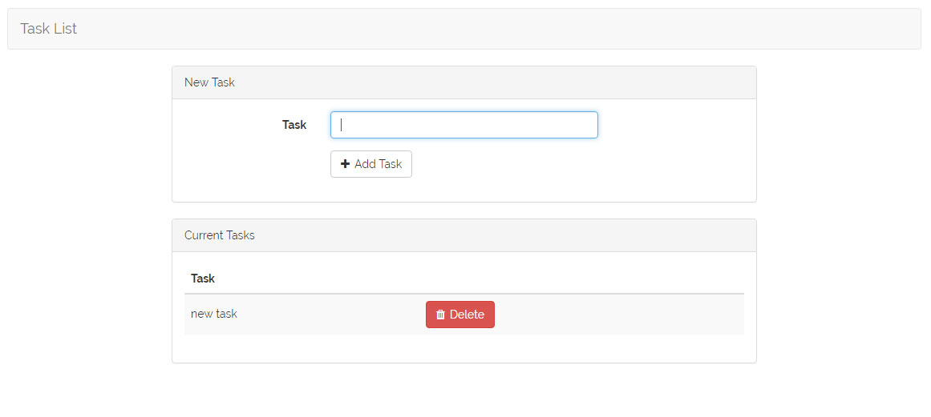

Slide 3
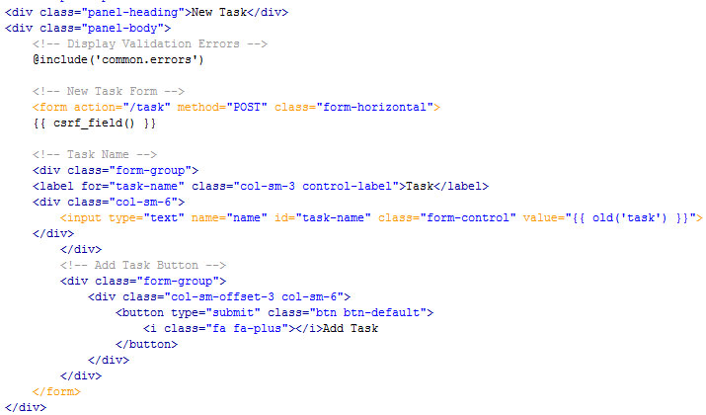
Add Record - Form

Slide 4
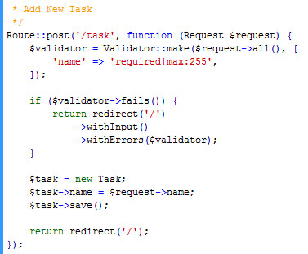
Add Record – Route and Controller

Slide 5
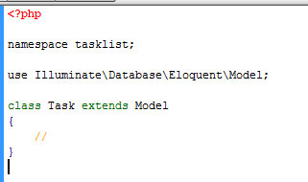
Model

Slide 6
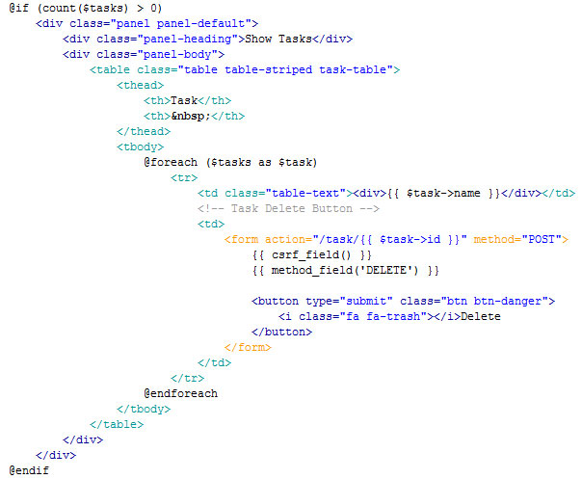
View Records

Slide 7
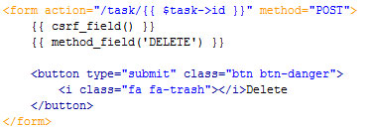
Delete Record

Slide 8
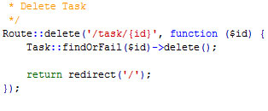
Delete Route - Controller

